Slide 1
MSDM 5003 Lecture 9 2 November 2021 Agent-Based Models
Outline:
9.1 Game theory models
9.2 El Farol Bar Problem
9.3 Minority Game

Slide 2
9.1 Game Theory Models
Agent-based models
An agent-based model is a computational model for simulating the actions and interactions of autonomous agents (both individual or collective entities such as organizations or groups).
It helps us to understand the behavior of a system and what governs its outcomes.
It combines elements of game theory, complex systems, emergence, computational sociology, multi-agent systems, and evolutionary programming.
Monte Carlo methods are used to understand the stochasticity of these models.
Applications
Detect distributions, trends and breakdowns
Prediction
Decision making (e.g. setting policies, prices and inventory levels)

Slide 3
Game Theory Models
Introduction (Econophysics Chapter 9)
Agent-based models are proposed to explain the stylized facts of market data (e.g. fat tails and volatility clustering).
Agents are selfish and they compete in the market for profits. Population games are required for the description.
What is a game?
A competition between two or more players, where each opponent acts in a rational manner, trying to resolve the conflict in their own favor.

Slide 4
Characteristics of Games
(1) The number of players is finite.
(2) There is a conflict of interest between the players.
(3) The players act rationally and intelligently.
(4) The rules governing the choices are specified and known to all players.
(5) Each player has a finite set of strategies.
(6) The players make individual decisions without communicating directly and simultaneously select their respective courses of action.
(7) The payoff is fixed and determined in advance.

Slide 5
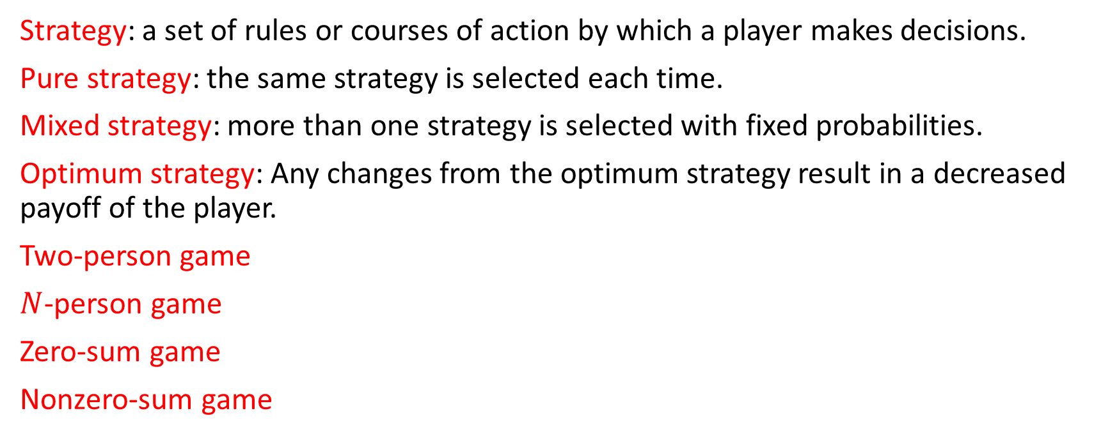
Concepts in Game Theory
Strategy: a set of rules or courses of action by which a player makes decisions.
Pure strategy: the same strategy is selected each time.
Mixed strategy: more than one strategy is selected with fixed probabilities.
Optimum strategy: Any changes from the optimum strategy result in a decreased payoff of the player.
Two-person game
$N$-person game
Zero-sum game
Nonzero-sum game

Slide 6
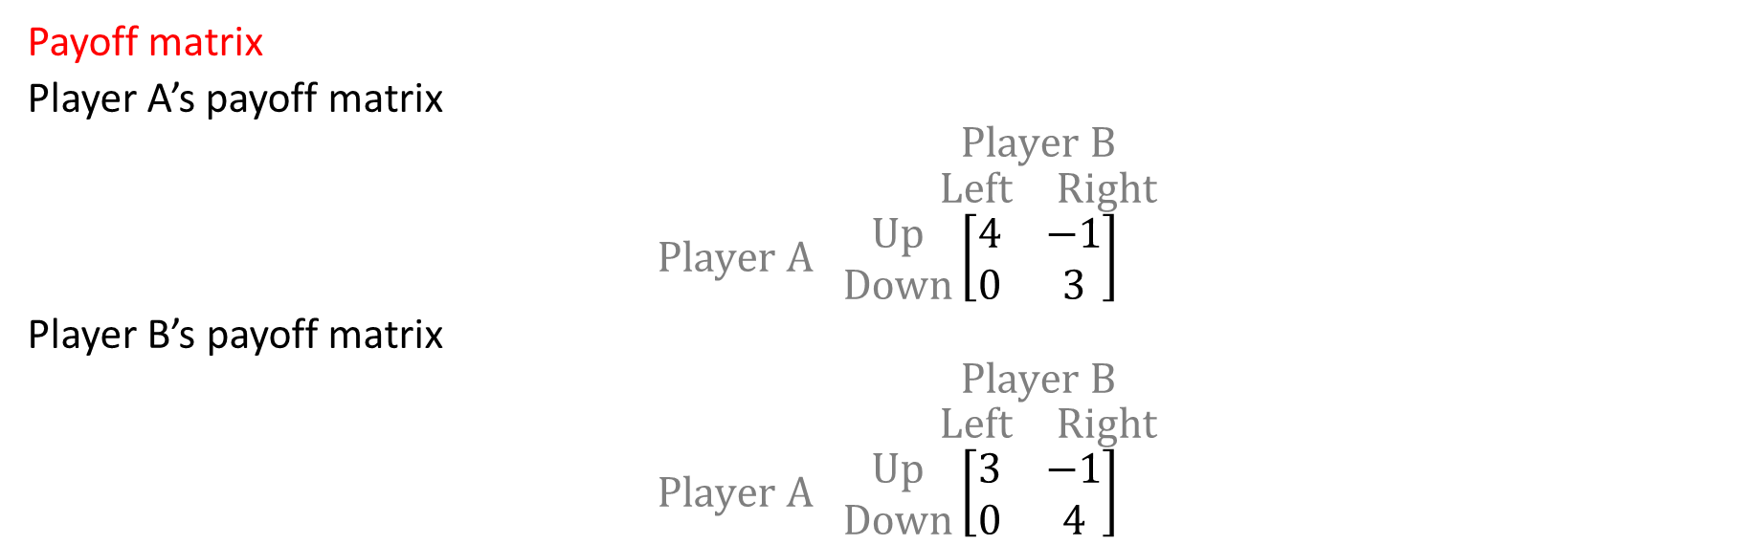
Payoff Table (Normal Form)
 | Player B chooses Left | Player B chooses Right
Player A chooses Up | 4, 3 | -1, -1
Player A chooses Down | 0, 0 | 3, 4
Payoff matrix
Player A’s payoff matrix
$$Player B$$
$$\begin{matrix}Left & Right\end{matrix}$$
$$Player A \begin{matrix}Up \\ Down\end{matrix}\left[\begin{matrix}4 & −1 \\ 0 & 3\end{matrix}\right]$$
Player B’s payoff matrix
$$Player B$$
$$\begin{matrix}Left & Right\end{matrix}$$
$$Player A \begin{matrix}Up \\ Down\end{matrix}\left[\begin{matrix}3 & −1 \\ 0 & 4\end{matrix}\right]$$

Slide 7
Nash equilibrium
If A’s choice is optimum given B’s choice, and B’s choice is optimum given A’s choice, then they are in Nash equilibrium. When the choices of the players are revealed, none of them want to change their behavior.
A game can have more than one Nash equilibrium.
There are also games with no Nash equilibria.
The optimum strategies may be pure strategies or mixed strategies.

Slide 8
The Prisoner’s Dilemma
 | Prisoner B stays silent (cooperates) | Prisoner B betrays (defects)
Prisoner A stays silent (cooperates) | Each serves 1 year | Prisoner A: 3 years Prisoner B: goes free
Prisoner A betrays (defects) | Prisoner A: goes free Prisoner B: 3 years | Each serves 2 years
If B cooperates, it is better for A to defect (goes free) than to cooperate (serves 1 year).
If B defects, it is also better for A to defect (serves 2 years) than to cooperate (serves 3 years).
Defect (D) is a dominant strategy than cooperate (C).
Similarly, it is better for B to defect.
(D,D) is the only Nash equilibrium of the game.
However, (C,C) is a better choice for both players (serve 1 year), but from the self-interest perspective, (C,C) is irrational.
There is a lot of work on how the game can achieve mutual cooperation.

Slide 9
Repeated Games
Strategies used by players in repeated (iterated) games can be very different from those in a single game.
In a competition of repeated prisoners’ dilemma game¹:
Greedy strategies perform poorly in the long run.
Altruistic strategies are better.
The winning deterministic strategy is tit for tat. (The player cooperates with the opponent as long as the opponent cooperates, but defects in the next step if the opponent defects so as to punish him.)
A slightly better strategy can be tit for tat with forgiveness. When the opponent defects, on the next move, the player sometimes cooperates anyway, with a small probability (around 1–5%).
Axelrod summarized that a successful strategy should be nice, retaliating, forgiving, and non-envious.
¹ Axelrod R (1984) The Evolution of Cooperation. ISBN 0-465-02121-2.

Slide 10
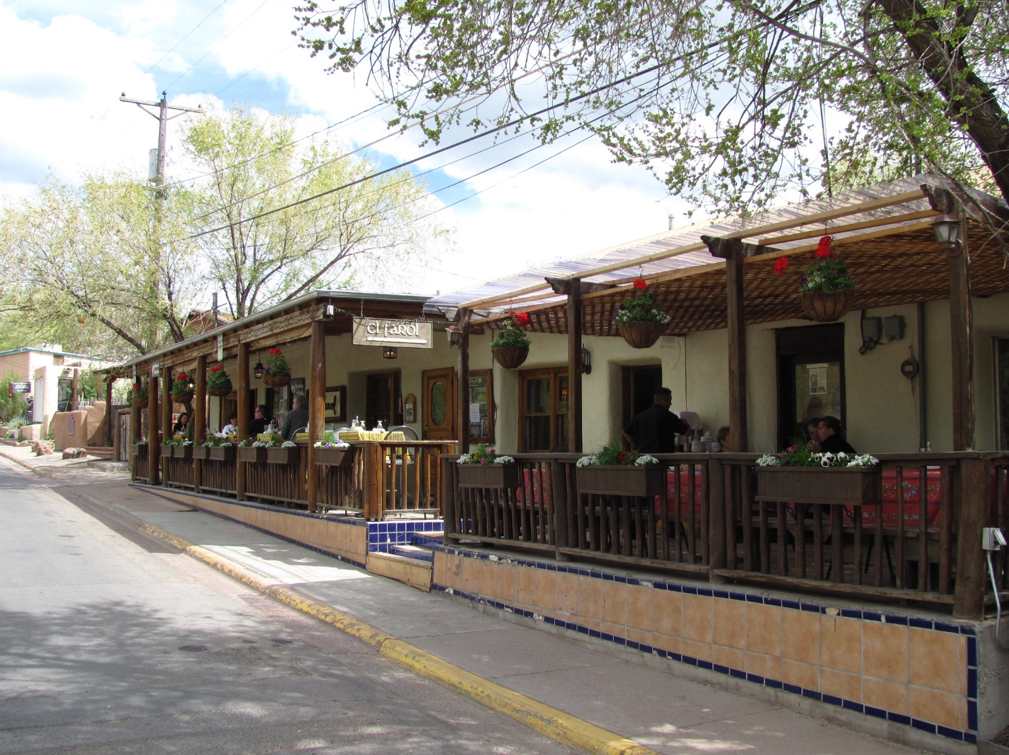
9.2 El Farol Bar Problem²
There are 100 patrons of El Farol bar, but the bar only has 60 seats.
Spending a Thursday evening in the bar is enjoyable only when fewer than 60 people attend.
The only information available to the agents is the numbers who came in past Thursdays.
² Arthur, W. Brian (1994). "Inductive Reasoning and Bounded Rationality" (PDF). American Economic Review: Papers and Proceedings. 84: 406–411.
Photo by John Phelan - Own work, CC BY 3.0, https://commons.wikimedia.org/w/index.php?curid=10536066

Slide 11
Bounded Rationality
Deductive reasoning may not work in this case (due to the uncertainty of too many other players’ decisions, whether they are rational, whether their decisions change with time …)
Inductive reasoning is needed (need to guess the likely behaviors of other players, need to adapt to changes in environment …)
Perfect rationality in economics cannot be assumed. Bounded rationality is more relevant.

Slide 12
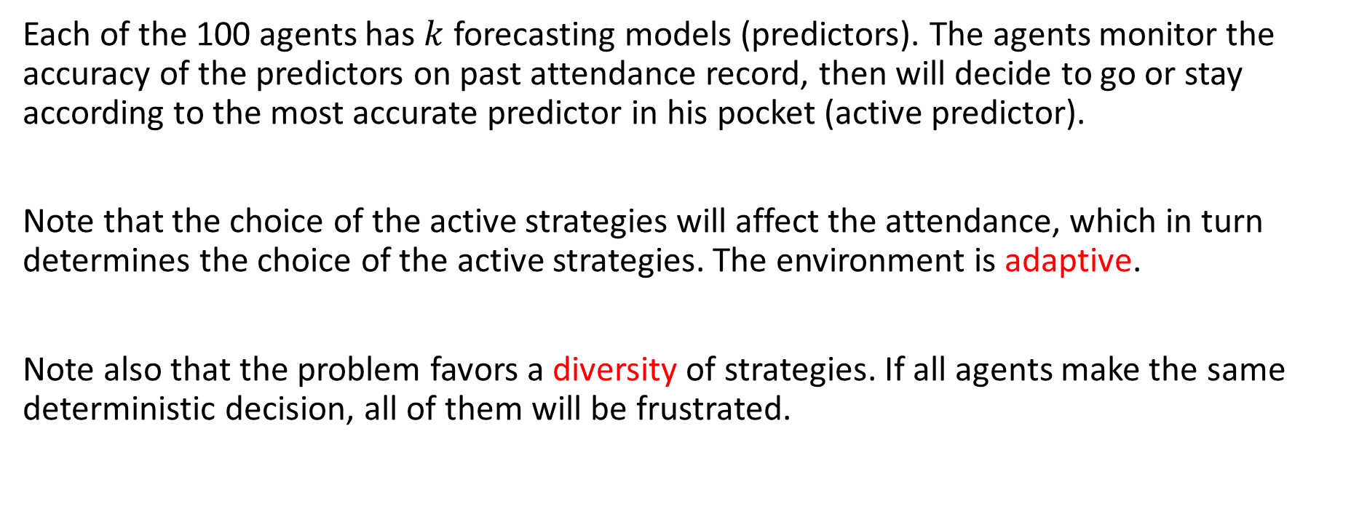
Computer Experiment
Each of the 100 agents has $k$ forecasting models (predictors). The agents monitor the accuracy of the predictors on past attendance record, then will decide to go or stay according to the most accurate predictor in his pocket (active predictor).
Note that the choice of the active strategies will affect the attendance, which in turn determines the choice of the active strategies. The environment is adaptive.
Note also that the problem favors a diversity of strategies. If all agents make the same deterministic decision, all of them will be frustrated.

Slide 13
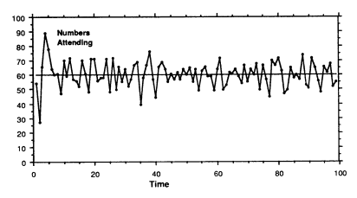
Self-Organization
The bar attendance converges to the capacity of the bar. The agents self-organize into an equilibrium state.

Slide 14
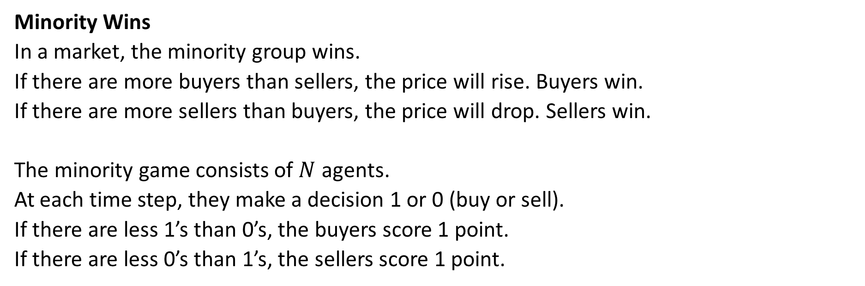
9.3 Minority Game^{3,4}
Minority Wins
In a market, the minority group wins.
If there are more buyers than sellers, the price will rise. Buyers win.
If there are more sellers than buyers, the price will drop. Sellers win.
The minority game consists of $N$ agents.
At each time step, they make a decision 1 or 0 (buy or sell).
If there are less 1’s than 0’s, the buyers score 1 point.
If there are less 0’s than 1’s, the sellers score 1 point.
³ Challet D, Marsili M, and Zhang Y-C (2005) Minority Games Oxford University Press.
⁴ Challet D and Zhang Y-C (1997) Emergence of cooperation and organization in an evolutionary game. Physica A 246 407-418.

Slide 15
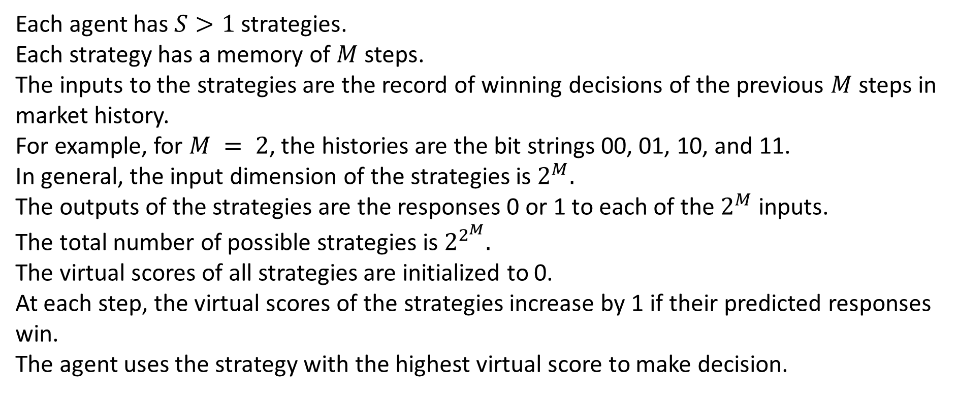
Decision Making
Each agent has $S>1$ strategies.
Each strategy has a memory of $M$ steps.
The inputs to the strategies are the record of winning decisions of the previous $M$ steps in market history.
For example, for $M = 2$, the histories are the bit strings 00, 01, 10, and 11.
In general, the input dimension of the strategies is $2^{M}.$
The outputs of the strategies are the responses 0 or 1 to each of the $2^{M}$ inputs.
The total number of possible strategies is $2^{2^{M}}.$
The virtual scores of all strategies are initialized to 0.
At each step, the virtual scores of the strategies increase by 1 if their predicted responses win.
The agent uses the strategy with the highest virtual score to make decision.

Slide 16
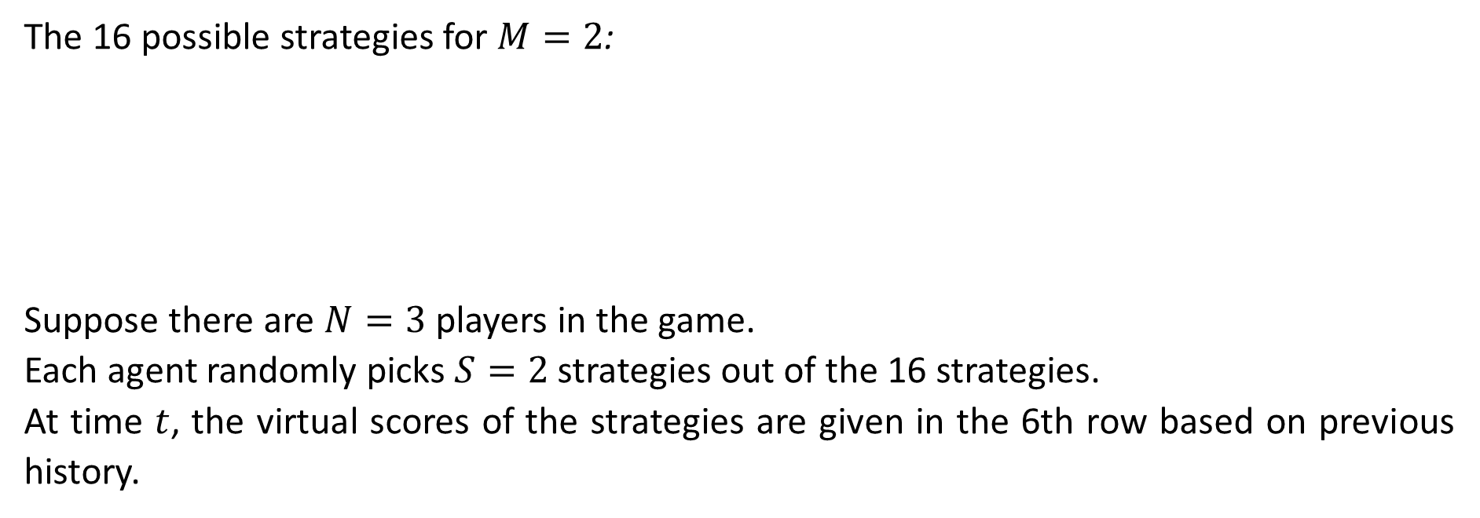
Example
The 16 possible strategies for $M=2$:
Suppose there are $N=3$ players in the game.
Each agent randomly picks $S=2$ strategies out of the 16 strategies.
At time $t$, the virtual scores of the strategies are given in the 6th row based on previous history.
 | 1 | 2 | 3 | 4 | 5 | 6 | 7 | 8 | 9 | 10 | 11 | 12 | 13 | 14 | 15 | 16
00 | 0 | 1 | 0 | 1 | 0 | 1 | 0 | 1 | 0 | 1 | 0 | 1 | 0 | 1 | 0 | 1
01 | 0 | 0 | 1 | 1 | 0 | 0 | 1 | 1 | 0 | 0 | 1 | 1 | 0 | 0 | 1 | 1
10 | 0 | 0 | 0 | 0 | 1 | 1 | 1 | 1 | 0 | 0 | 0 | 0 | 1 | 1 | 1 | 1
11 | 0 | 0 | 0 | 0 | 0 | 0 | 0 | 0 | 1 | 1 | 1 | 1 | 1 | 1 | 1 | 1
 | 5 | 6 | 4 | 7 | 11 | 9 | 10 | 8 | 16 | 20 | 12 | 3 | 13 | 14 | 0 | 7
Player 1 picks strategies 2 and 14.
Player 2 picks strategies 4 and 12.
Player 3 picks strategies 8 and 16.

Slide 17
Player 1’s Decision
 | 1 | 2 | 3 | 4 | 5 | 6 | 7 | 8 | 9 | 10 | 11 | 12 | 13 | 14 | 15 | 16
00 | 0 | 1 | 0 | 1 | 0 | 1 | 0 | 1 | 0 | 1 | 0 | 1 | 0 | 1 | 0 | 1
01 | 0 | 0 | 1 | 1 | 0 | 0 | 1 | 1 | 0 | 0 | 1 | 1 | 0 | 0 | 1 | 1
10 | 0 | 0 | 0 | 0 | 1 | 1 | 1 | 1 | 0 | 0 | 0 | 0 | 1 | 1 | 1 | 1
11 | 0 | 0 | 0 | 0 | 0 | 0 | 0 | 0 | 1 | 1 | 1 | 1 | 1 | 1 | 1 | 1
 | 5 | 6 | 4 | 7 | 11 | 9 | 10 | 8 | 16 | 20 | 12 | 3 | 13 | 14 | 0 | 7
Suppose the market history is 01001010100010.
The input to the strategies becomes 10.
Output of strategy 2 = 0
Output of strategy 14 = 1
Since the virtual score of strategy 14 is higher (14 > 6), decision of player 1 = 1.
Player 1:

Slide 18
Player 2 and 3’s Decision
 | 1 | 2 | 3 | 4 | 5 | 6 | 7 | 8 | 9 | 10 | 11 | 12 | 13 | 14 | 15 | 16
00 | 0 | 1 | 0 | 1 | 0 | 1 | 0 | 1 | 0 | 1 | 0 | 1 | 0 | 1 | 0 | 1
01 | 0 | 0 | 1 | 1 | 0 | 0 | 1 | 1 | 0 | 0 | 1 | 1 | 0 | 0 | 1 | 1
10 | 0 | 0 | 0 | 0 | 1 | 1 | 1 | 1 | 0 | 0 | 0 | 0 | 1 | 1 | 1 | 1
11 | 0 | 0 | 0 | 0 | 0 | 0 | 0 | 0 | 1 | 1 | 1 | 1 | 1 | 1 | 1 | 1
 | 5 | 6 | 4 | 7 | 11 | 9 | 10 | 8 | 16 | 20 | 12 | 3 | 13 | 14 | 0 | 7
Player 2:
Output of strategy 4 = 0
Output of strategy 12 = 0
Since the virtual score of strategy 4 is higher (7 > 3), decision of player 1 = 0.
Output of strategy 8 = 1
Output of strategy 16 = 1
Since the virtual score of strategy 8 is higher (8 > 7), decision of player 1 = 1.
Since 0 is the minority, player 2 wins, and players 1 and 3 lose.
Player 3:

Slide 19
Virtual Score Update
The virtual scores of the 16 strategies are updated to those strategies predicting 0:
 | 1 | 2 | 3 | 4 | 5 | 6 | 7 | 8 | 9 | 10 | 11 | 12 | 13 | 14 | 15 | 16
00 | 0 | 1 | 0 | 1 | 0 | 1 | 0 | 1 | 0 | 1 | 0 | 1 | 0 | 1 | 0 | 1
01 | 0 | 0 | 1 | 1 | 0 | 0 | 1 | 1 | 0 | 0 | 1 | 1 | 0 | 0 | 1 | 1
10 | 0 | 0 | 0 | 0 | 1 | 1 | 1 | 1 | 0 | 0 | 0 | 0 | 1 | 1 | 1 | 1
11 | 0 | 0 | 0 | 0 | 0 | 0 | 0 | 0 | 1 | 1 | 1 | 1 | 1 | 1 | 1 | 1
 | 5 | 6 | 4 | 7 | 11 | 9 | 10 | 8 | 16 | 20 | 12 | 3 | 13 | 14 | 0 | 7
 | + | + | + | + |  |  |  |  | + | + | + | +
 | 6 | 7 | 5 | 8 | 11 | 9 | 10 | 8 | 17 | 21 | 13 | 4 | 13 | 14 | 0 | 7

Slide 20
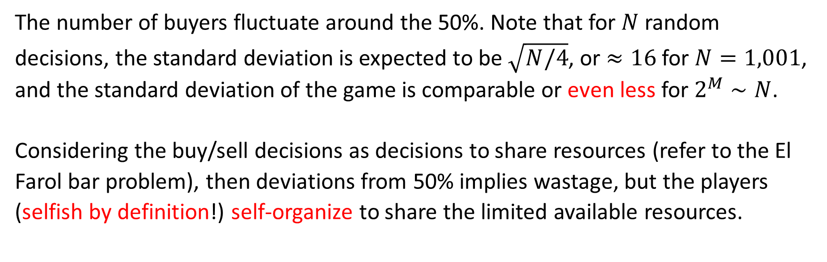
Results
The number of buyers fluctuate around the 50%. Note that for $N$ random decisions, the standard deviation is expected to be $\sqrt{N/4}$, or $≈16$for $N=1,001$, and the standard deviation of the game is comparable or even less for $2^{M}∼N$.
Considering the buy/sell decisions as decisions to share resources (refer to the El Farol bar problem), then deviations from 50% implies wastage, but the players (selfish by definition!) self-organize to share the limited available resources.

Slide 21
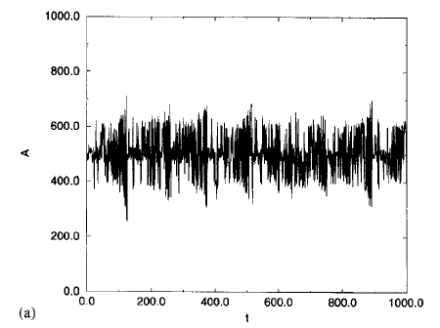
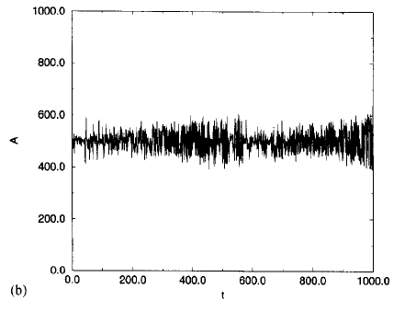
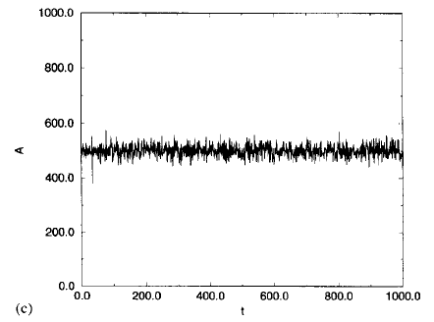
Memory Size Matters
Number of buyers as a function of time for a population of 1,001 players (a) $M=6$, (b)$M=8$, (c) $M=10$.

Slide 22
Minority Game and Arbitrage
Suppose there is a strategy that has a higher probability of winning, then it will become active. It will become a majority strategy and will no longer win.
In finance, there are arbitrage opportunities. In an efficient market, traders will take advantage of the arbitrage opportunities, and the opportunities will disappear.

Slide 23
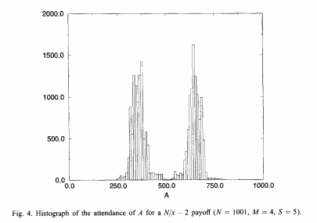
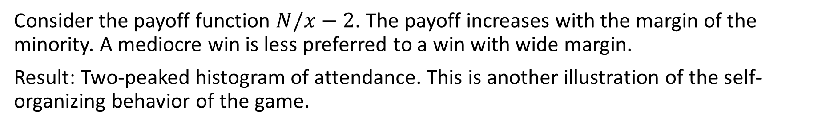
Payoff Functions Favoring Small Minority
Consider the payoff function $N/x−2$. The payoff increases with the margin of the minority. A mediocre win is less preferred to a win with wide margin.
Result: Two-peaked histogram of attendance. This is another illustration of the self-organizing behavior of the game.

Slide 24
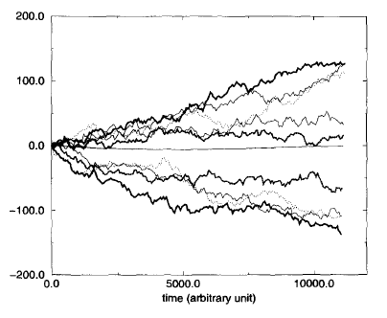
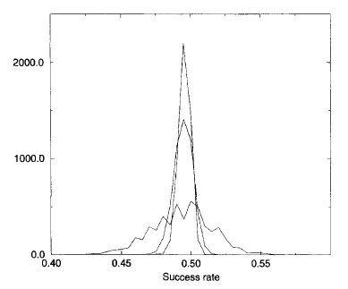
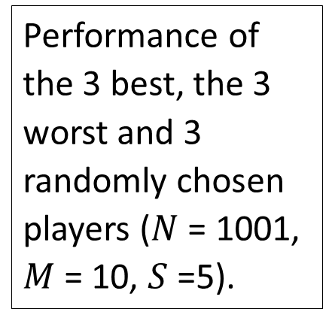
Other Statistics
Performance of the 3 best, the 3 worst and 3 randomly chosen players ($N$ = 1001, $M$ = 10, $S$ =5).
Different distributions of the average value of all the strategies with increasing iterations (1000, 5000 and 10000).
Note that all strategies have similar performance in the t→∞ limit. The diversity of agents’ performance is less due to the existence of intrinsically good or bad strategies, but more due to their ability to adapt to changes.

